Slide 1
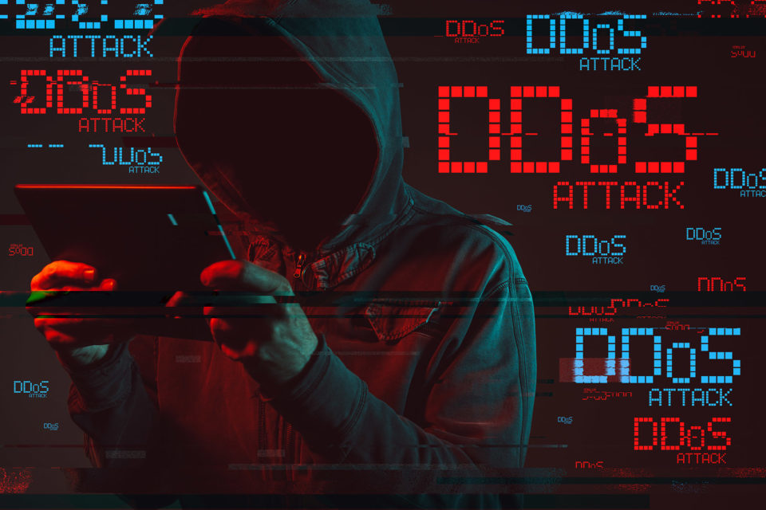
Simulation of DoS Attack
This presentation details the simulation of a Denial of Service (DoS) attack, exploring its mechanisms, impact, and essential mitigation strategies. We'll delve into the technical aspects of DoS versus Distributed Denial of Service (DDoS) attacks, focusing on packet patterns and system behaviour under duress.
ROHAN SINGH
Roll No: TEC/IIT/SS25/002 B-Tech ITE (4th Sem)
Internship at IIT JammuConducted by: Techible & Department of ITE

Slide 2

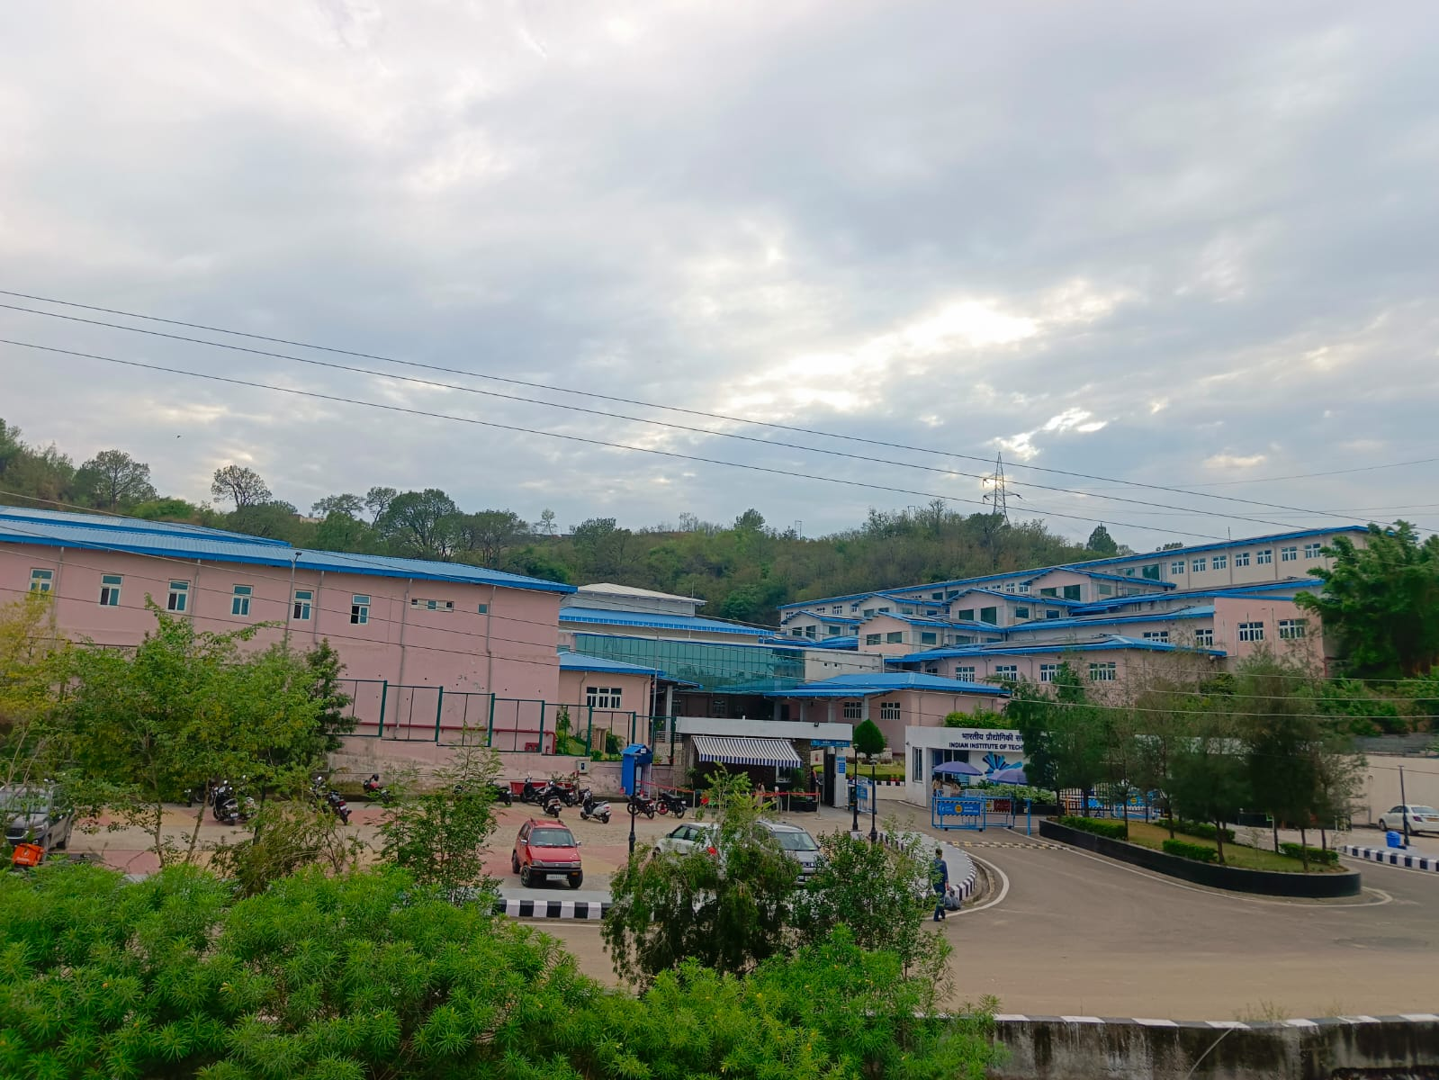
Internship Context
1
Program Duration
A comprehensive 6-week Summer School Internship & Training Program in 2025.
2
Host Institution
Conducted at the prestigious Indian Institute of Technology Jammu.
3
Core Focus
Specialised training in Ethical Hacking & Cybersecurity domains.
4
Key Project
In-depth simulation and analysis of a Denial of Service (DoS) Attack.

Slide 3



Objectives of the Project
DoS Mechanism
Offensive Tools
Traffic Analysis
To gain a thorough understanding of how DoS attacks function at a fundamental level.
To practically apply offensive security tools for network flooding scenarios.
To effectively analyse network traffic patterns using Wireshark during an attack.
Performance Impact
Mitigation Techniques
To quantify and observe the performance degradation on target systems.
To familiarise ourselves with various strategies for defending against DoS attacks.

Slide 4
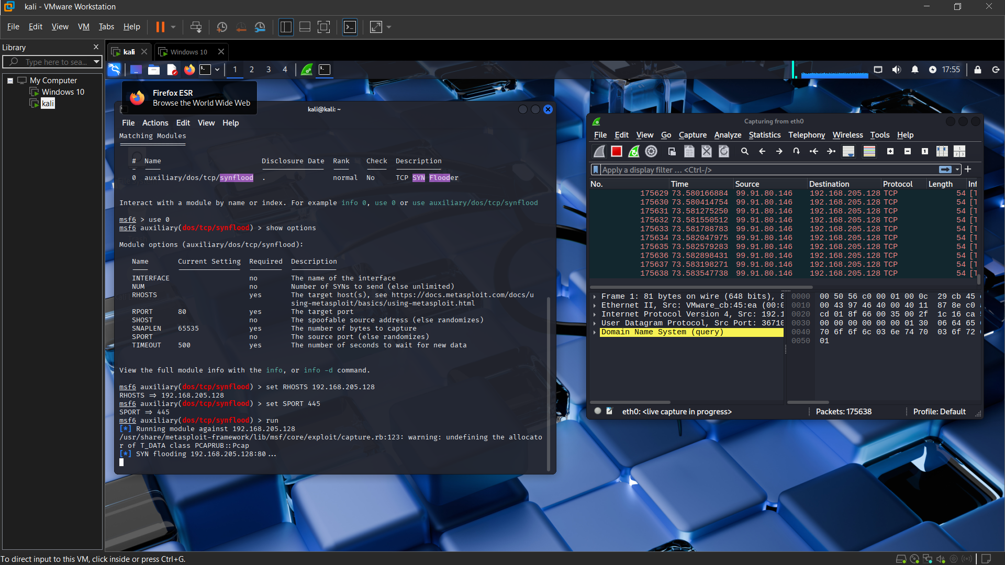
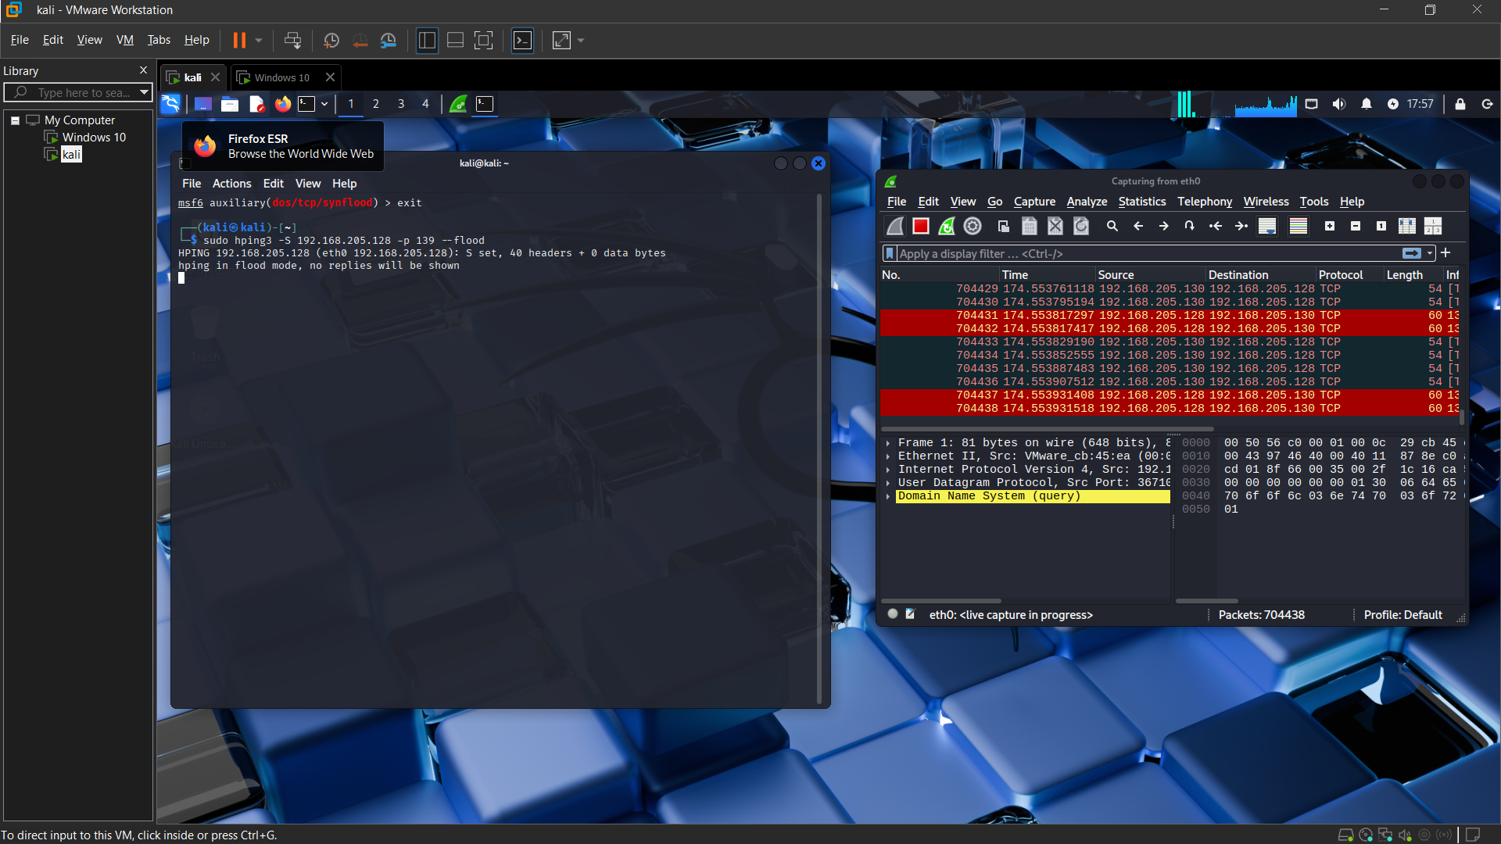
Tools & Technologies Used
Operating Systems
Kali Linux: Utilised as the primary attacker machine for launching DoS attacks.
Windows 10: Configured as the target system to observe attack impact.
Attack Tools
hping3: A powerful command-line tool for crafting and sending custom TCP/IP packets.
Metasploit Framework: Employed for leveraging various exploit modules, including SYN flood attacks.
Network Analysis
Wireshark: An essential network protocol analyser for capturing and inspecting packet flow.
Virtual Environment
VMware Workstation: Used to set up an isolated virtual network for safe experimentation.

Slide 5
Methodology – Steps
1
Step 1: Environment Setup
Installed Kali Linux (attacker) and Windows 10 (target) in VMware. Configured both VMs on the same virtual network segment. Verified IP addresses using ifconfig (Kali) and ipconfig (Windows) to ensure connectivity.
2
Step 2: Firewall Configuration
Temporarily disabled the Windows Defender Firewall on the target system to allow unrestricted inbound traffic, crucial for the DoS attack to succeed and demonstrate its impact.
3
Step 3: Pre-attack Baseline
Conducted preliminary network checks using ping to assess baseline latency and packet loss. Captured initial network traffic with Wireshark to establish a normal operational baseline for comparison.
4
Step 4: DoS Attacks with hping3
Executed a TCP SYN Flood on Port 135 (NetBIOS Session Service) and a Large Packet SYN Flood on Port 22 (SSH). Observed significant CPU usage spikes, system unresponsiveness, and network saturation on the target.
5
Step 5: DoS with Metasploit
Utilised the synflood module within Metasploit Framework. Set the Remote Host (RHOST) to the target's IP and Remote Port (RPORT) to a common service port. The target system experienced severe freezing and lag, confirming service degradation.

Slide 6
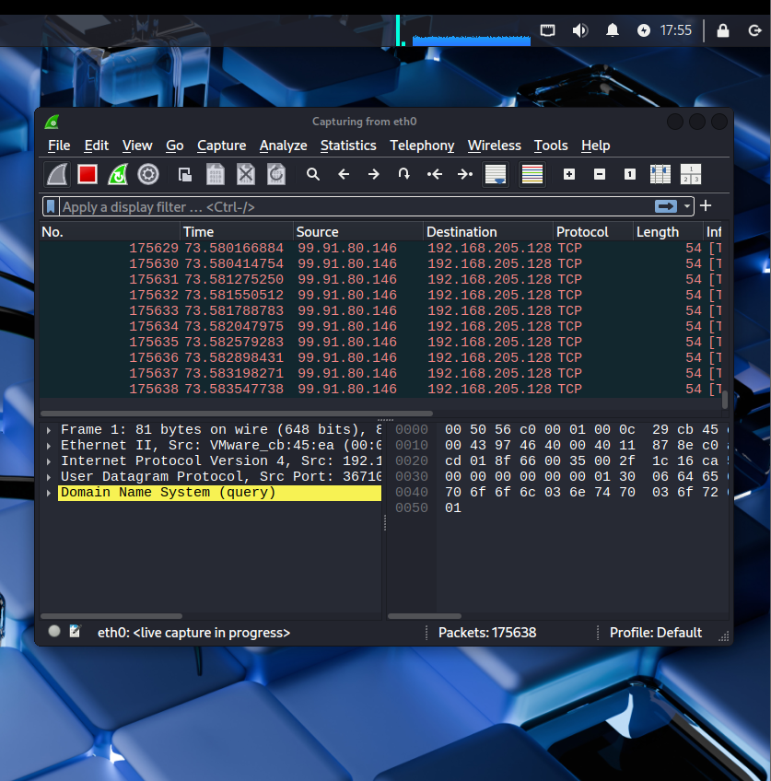
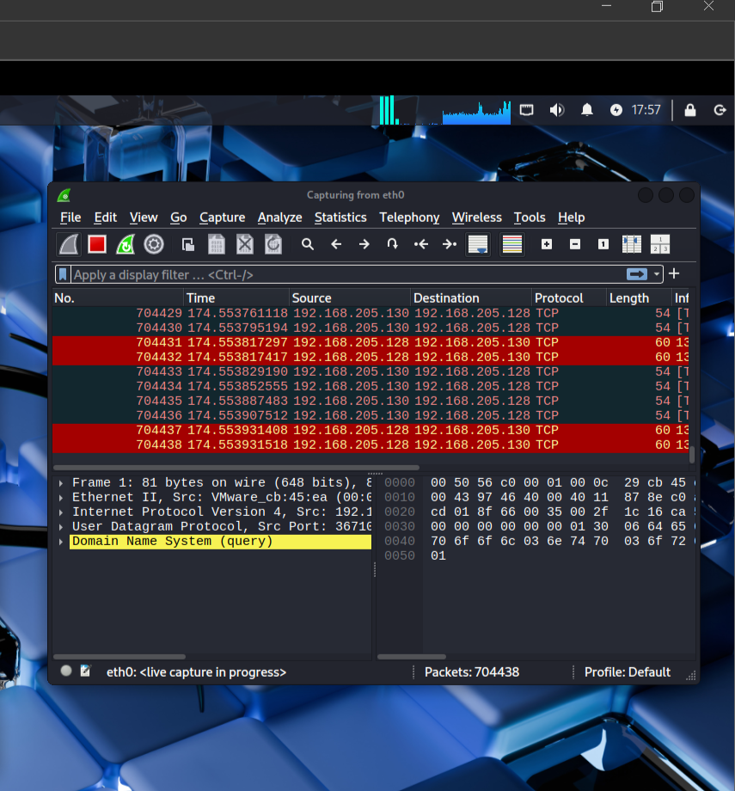
Monitoring & Observations
Wireshark Analysis
Network Latency
Wireshark captures confirmed an overwhelming volume of SYN packets directed at the target, clearly demonstrating the flood's success. This high volume choked the network interface.
Observed a drastic increase in network latency and packet loss, disrupting normal network communication to and from the target.
Resource Impact
CPU Utilisation
While memory impact was minimal, the primary resource contention was on the CPU and network stack, which were saturated by the flood.
The target system's CPU usage consistently peaked at 100%, indicating that the operating system was struggling to process the excessive incoming connection requests.
System Unresponsiveness
The Windows 10 target became completely unresponsive, with applications freezing and input delays, simulating a real-world DoS impact.

Slide 7
Skills Learned & Challenges Faced
Skills Learned
Challenges Faced
Deepened understanding of DoS attack methodologies and their network-level implications.
Navigating and bypassing firewall restrictions, requiring a deep understanding of network rules.
Proficient use of hping3 for crafting and launching various types of packet floods.
Dealing with significant network lag and packet loss, which complicated attack execution and monitoring.
Execution and parameterisation of Metasploit modules, specifically for network attacks.
Optimising command parameters for hping3 and Metasploit to achieve desired attack intensity.
Enhanced awareness of firewall configurations and their critical role in network security.
Overcoming the initial complexity of Metasploit Framework's vast array of modules and options.
Advanced skills in using Wireshark for real-time network traffic analysis and anomaly detection.
Ensuring accurate monitoring and verification of attack impact, distinguishing between attack-induced and environmental issues.
Techniques for monitoring system resources (CPU, network) under attack conditions.

Slide 8
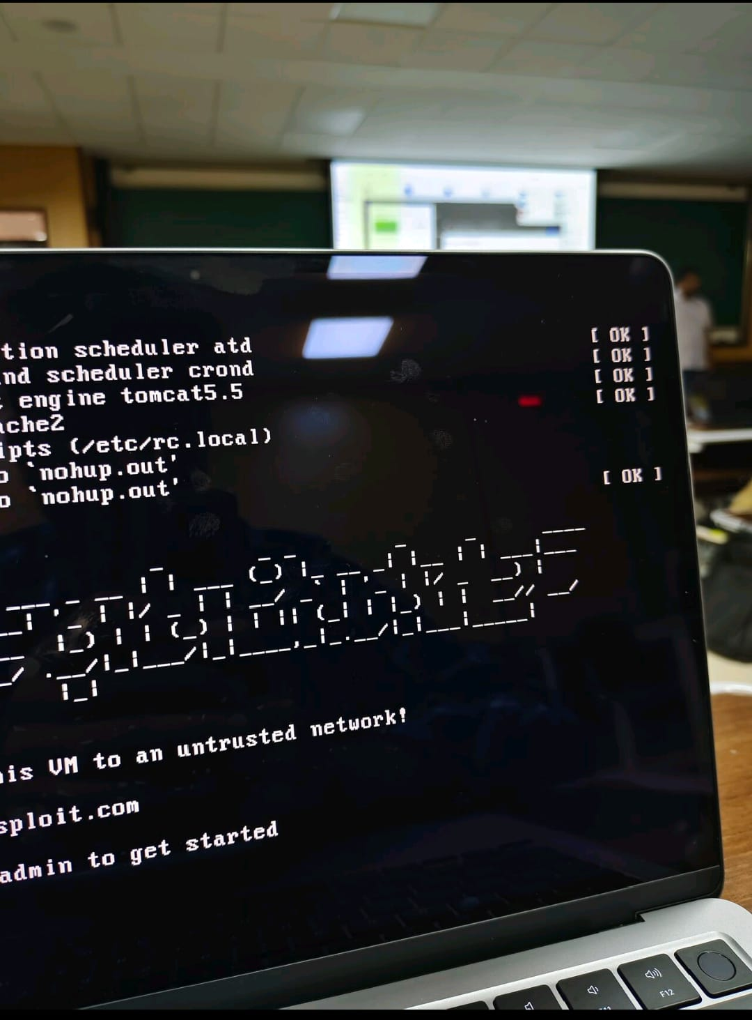
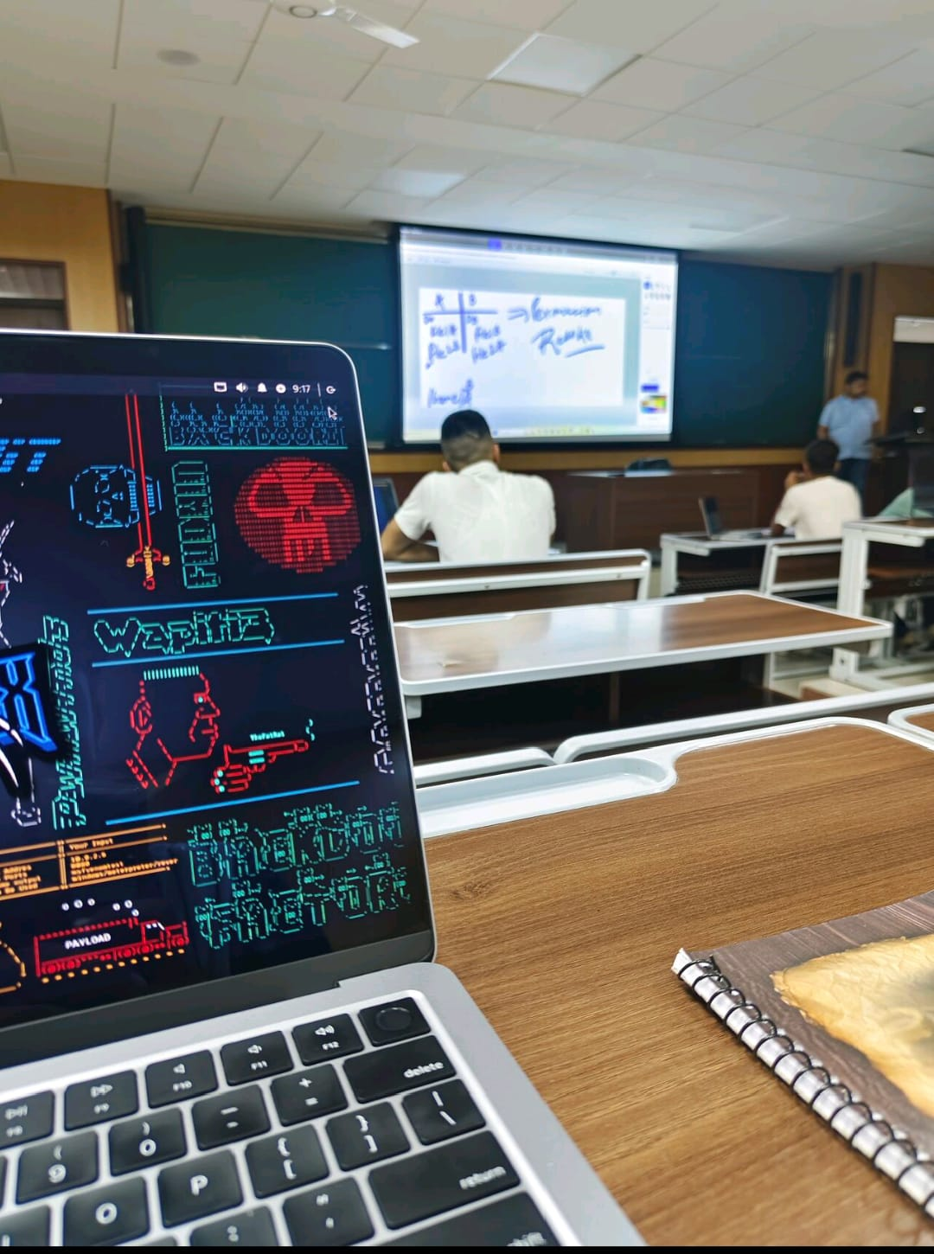
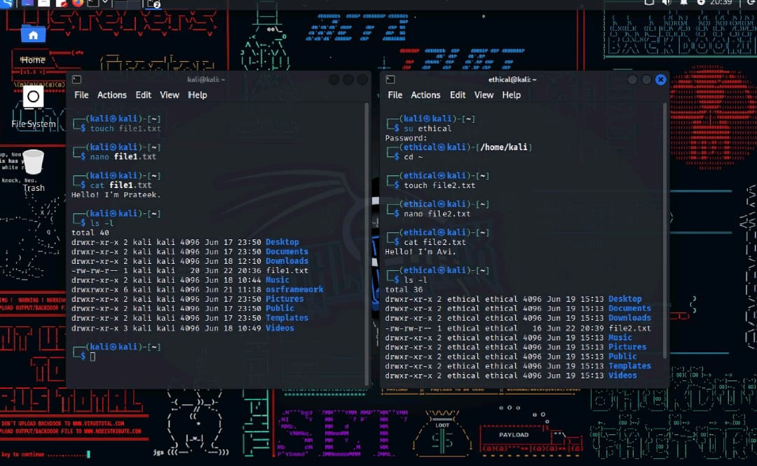
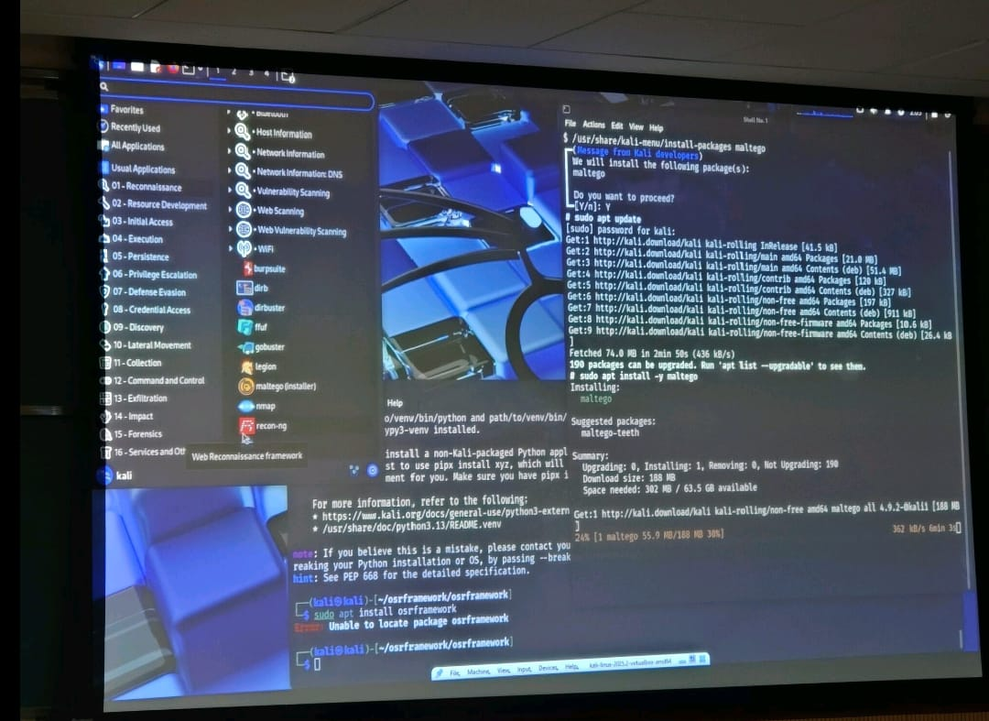
Key Takeaways
1
Hands-on Simulation
2
Theory to Practice
Gained invaluable practical experience in simulating DoS attacks, moving beyond theoretical knowledge.
Successfully bridged the gap between academic understanding and real-world application of cybersecurity concepts.
3
Defence Importance
4
Ethical Considerations
Understood the paramount importance of robust defensive strategies in protecting against network attacks.
Reinforced the critical ethical considerations and responsibilities inherent in cybersecurity practices.

Slide 9








Conclusion
Technical & Problem-Solving Growth
Penetration Testing Expertise
This internship significantly enhanced both technical skills in networking and cybersecurity, as well as crucial problem-solving abilities when encountering real-world attack scenarios.
Gained practical expertise in penetration testing methodologies, specifically concerning denial of service attacks and their detection.
Defensive Measures Appreciation
Future Role Preparation
Developed a deeper appreciation for the design and implementation of effective defensive security measures and protocols.
The experience has prepared me for future roles encompassing both offensive and defensive aspects of cybersecurity.

Slide 10
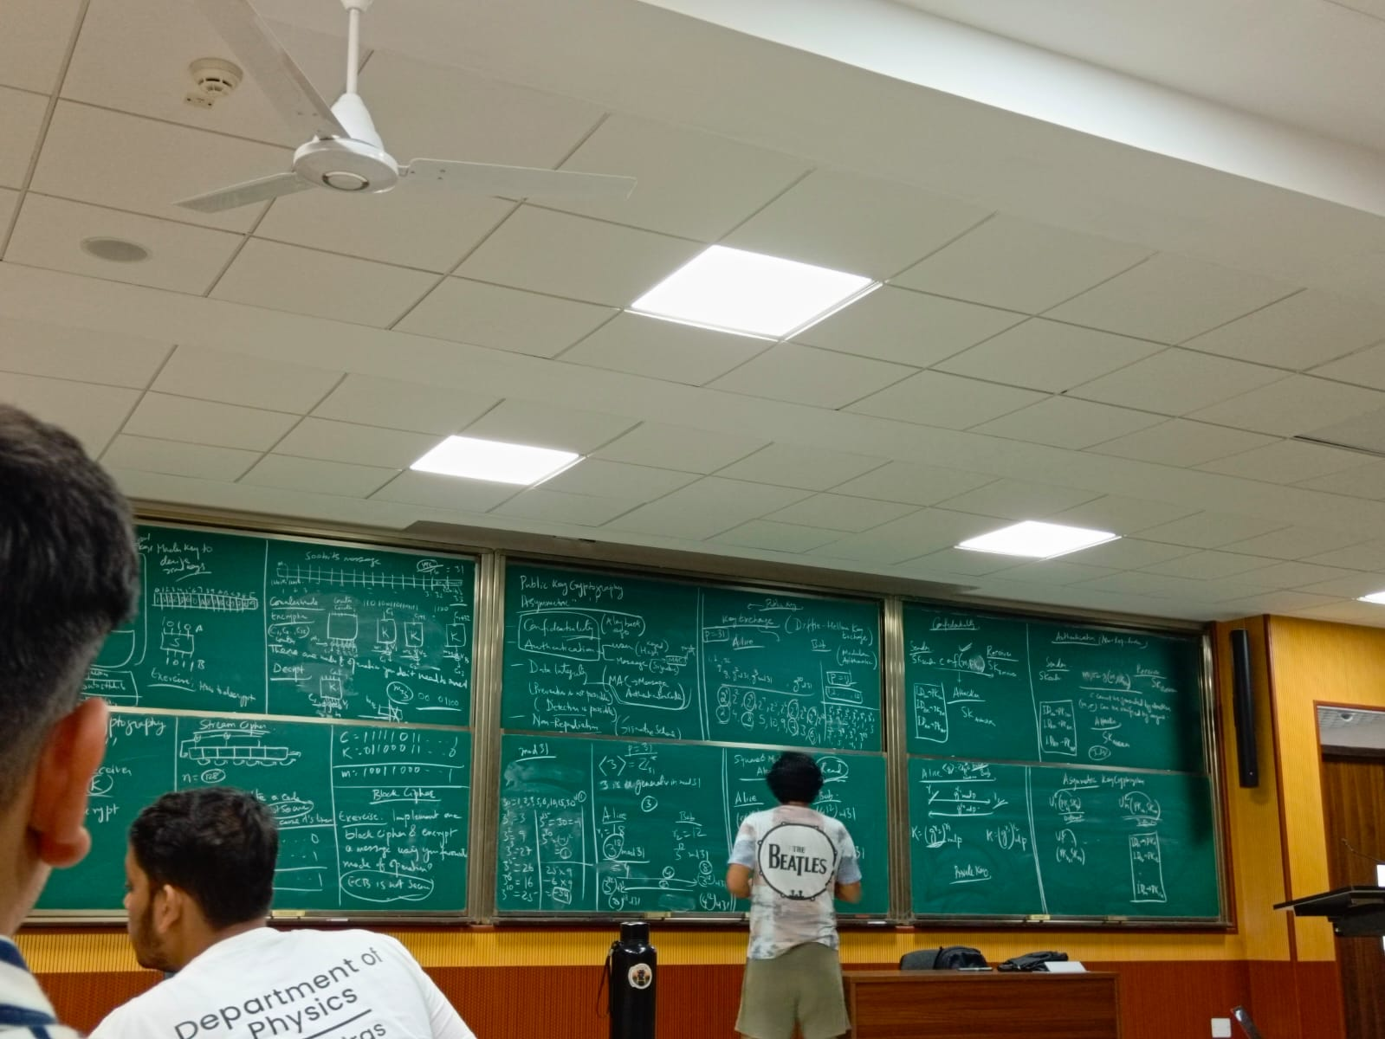
Acknowledgement
I extend my sincere gratitude to:
Mentors: Mr. Ankit Pulkit, Ms. Aishwarya Upadhyay, and Dr. Sumit Kumar Pandey for their invaluable guidance and support throughout this project.
Institutions: Indian Institute of Technology Jammu, Techible, and I3C-IIT Jammu for providing this incredible learning opportunity and the necessary resources.
Peers & Coordinators: For their collaborative spirit, unwavering support, and insightful discussions that greatly contributed to the success of this internship.

